Slide 1

Student Record Management
System
SUBMITED BY:
Shubham D. Pagarwar
Arvind K. Rahangdale
Rajni A. Bisen
Nikki K. Katare
Devendra P. Bante
Swapnil Dumbhare
DEPARTMENT OF COMPUTER ENGINEERING
GOVERNMENT POLYTECHNIC GONDIA

Slide 2

Introduction to Our System
A Student Management System (SMS) is designed to help collages for management of dental student.
The Student Record Management System avoids an complexity of managing the student record mannualy on the paper.

Slide 3
We have to organize the internal and external record related to college for the different purposes.
Objectives to Our System
We have to maintain the student record as per the authentication and the student registration.
To Study the JDBC Technics in Java for the use of connectivity of our source code project to the database for storing the student record in the database.
To Study the Swings Technics of the GUI components which helps to design the Frames in our project . And about linking technic to link this frames.

Slide 4
Scope & Limitation
Scope:
Our project scope is not a big. Its an only prefer to the college level . Its not an web based application , Its an desktop based application which helps to provide an interactive purpose for the college.
Limitation:
Our System is only for the limited student which are belongs to our college and the department.
Our System can only store the record about the college session.it does not contain the data about the personal details of the student.
The security should be limited only the registration of the student in terms of their authentication.

Slide 5
Analysis of Our System
Feasibility Study:
Our System does not provide more security to
the student identification like biological security. It provide only an security of student identification by the help of their image and the signature.
Existing System:
We should only prefer for these System is to the database System with the java language like JDBC.
Problem Definition:
If we did not take the help of these system than we can face many problem in management of student record. Because this System provides an interactive feature for registering , deleting , modifying the student data.

Slide 6
Provides Complete Security of record

Slide 7
User Goals For a System
User goals for a “ Student Records Management System” Practicality: The system is quite stable and can be operated by the people with average intelligence.
2. Efficiency: We tried to involve accuracy, timeliness and comprehensiveness of the system output.
3. Flexibility: We have tried that the system should be modifiable depending on the changing needs of the user.

Slide 8
Such modifications should entail extensive reconstructing or recreation of software. It should also be portable to different computer systems. SECURITY PURPOSE Allow only authorized faculty and staff to insert, save & show student records. Allow only administrator for insert, update, delete, save, show student records.
The information store in the database should be secured by the database security. The database security provides an interactive possibility to enter the password in the form than we can retrieve the record from the database.

Slide 9
Database User Frame

Slide 10
Design of an System
Students
University
Administration
Faculty
Student
Application
Grade
Posting
Admissions
Self- Service
Enrollment
Registrar
External Focus
Class
Schedule
Payment
Records
Finance
Records
Access
Student
Progress

Slide 11
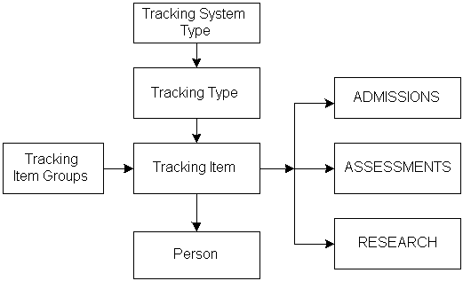
Tracking Process

Slide 12
Tools Used : java Language
Java is a Purely object – oriented Language . In the Java
there are the certain important tools are used in the our
System. JDBC is an important tools are used for connecting
To the database which is used for storing the student data.
JDBC is a Java database connectivity API that is
a part of the Java Enterprise APIs from Java Soft .
From a developer's point of view, JDBC is the first
standardized effort to integrate relational databases
with Java programs. JDBC has opened all the relational
power that can be mustered to Java applets and applications.

Slide 13
Another Tools are used in our System is for making a frames. GUI components are most important. & those important components are available in java.for ex.Swings.
A graphical user interface (GUI) presents a user-friendly mechanism for interacting with an application. A GUI gives an application a distinctive “look and feel”. A GUI component is an object with which the user interacts via the mouse, the keyboard or another form of input, such as voice recognition.
GUI Components: We learn about many of
Java’s so-called Swing GUI components from the javax.swing package. We cover other
GUI components as they’re needed throughout the rest of the book.

Slide 14
Conclusion:
The system has been developed for the given condition and is found working effectively . The developed system is flexible and changes whenever can be made easy. Using the facilities and functionalities of Java, the software has been developed in a neat and simple manner , thereby reducing the operators work. The speed and accuracy are maintained in proper way. The user friendly nature of this software developed in Java framework is very easy to work with both for the higher management as well as other employees with little knowledge of computer. The results obtained will fully satisfactory from the user point of view.

Slide 15
References:
http://www4.comp.polyu.edu.hk
http://seminarprojects.com
http://www.freestudentprojects.com
http://www.kashipara.com

Slide 16
Thank you

